Slide 1

Studying musical evolution
Pierre L. & Ubaid J.

Slide 2
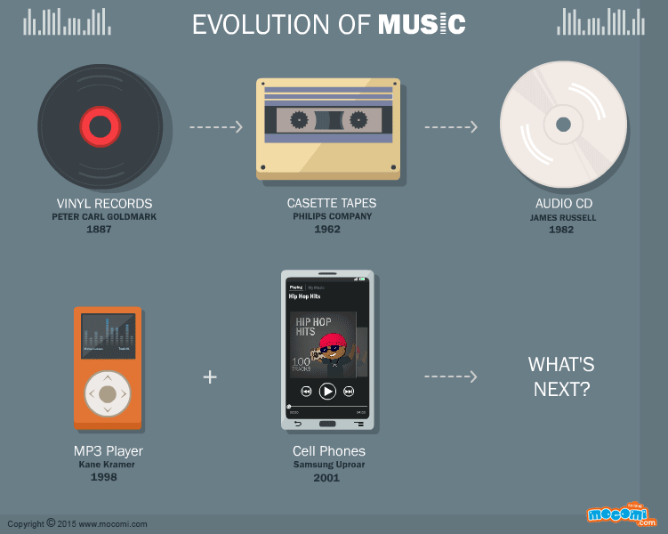
Research Question using ML
Macro-evolution of culture: long hamstrung by sampling and analysis (Savage 2019)
Matters to academics and industry alike (Terroso-Saenz et al. 2019)
Now finally possible: big data and computational methods (Youngblood et al. 2019)
Baseline view still missing:
RQ: How has Western music evolved over the last 100 years?

Slide 3
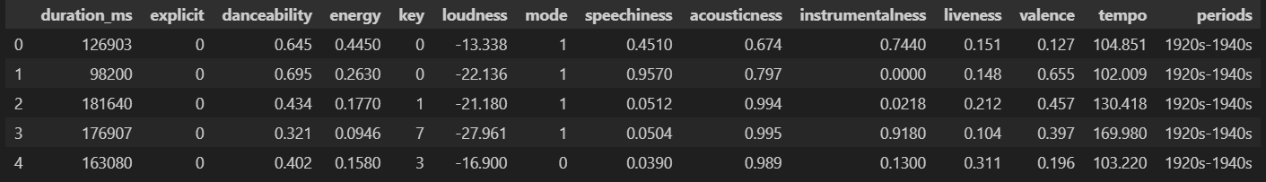
Data
Publicly available Spotify dataset comprising of musical attributes for 329,445 observations (post-cleaning) between 1921 - 2020 and 14 variables (target + features).
Target Variable: periods - musical period the song belonged to (multi-class classification task)
Train-Test Split: 0.7:0.3 - stratified by categories of the target variable, i.e., periods.
X_train.shape = 230,611 - 23
X_test.shape = 98,834 - 23

Slide 4
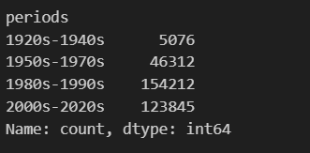
Data (cont.)
Feature Space:
10 numerical features, e.g., duration_ms, acousticness, tempo, etc.
3 categorical features, e.g., key, mode, explicit.
Data Preprocessing Steps
No missing data for variables used in the model.
Outlier removal for numerical features - observations falling outside the (Q1 - 1.5 * IQR) and (Q3 + 1.5 * IQR) range.
For categorical variables, sufficient samples for each category - no modification required.
Standard Scaling for numerical features, One-Hot Encoding for categorical variables
Distribution of the Target Variable

Slide 5
Model Exploration:
Multi-class Logistic Regression Model

Slide 6
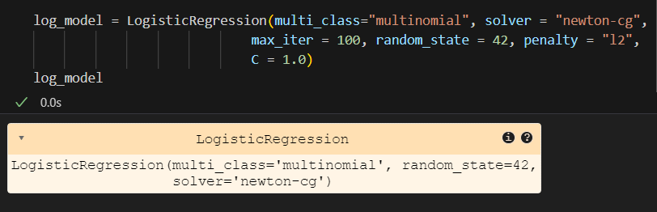
Multi-class Logistic Regression Model
Parameters Tuned
Solvers: tested different solvers including "lbfgs", "newton-cg", "saga", "sag".
C (Regularization Strengths): [0.001, 0.01, 0.1, 1.0, 10.0, 100.0]
Penalty: restricted to using “l2” due to multinomial classification
Marginal to non-existent differences while tuning different parameters - overall accuracy hovered around 66%
Final Model
Accuracy: ~66% or 0.658
Weighted averages:
precision = 65% or 0.65
recall = 66% or 0.66
f1-score = 65% or 0.65

Slide 7
RandomForest Classifier
Why, rather than DecisionTree? More robust, given multiple classes.
BEST | MINIMAL IMPACT | WORST
N_estimators (runtime issues) | Criterion (node splitting) | Min_impurity_decrease
Max_depth | Max_features (cats/ints)
Min_samples_leaf (small vals)
Min_samples_split
Max_leaf_nodes (small vals)

Slide 8
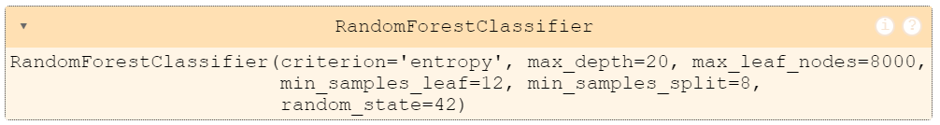
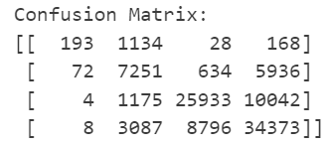
RandomForest Classifier
Final model after grid search → though did not include parameter defaults
Confusion Matrix
*Graph visualization too large for powerpoint; see github repo.

Slide 9
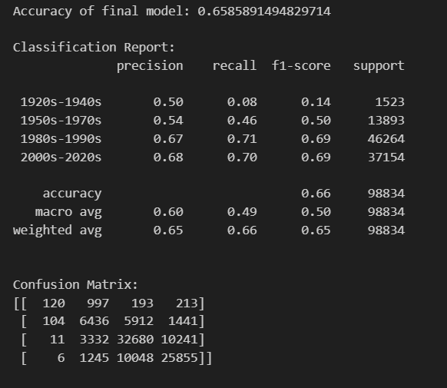
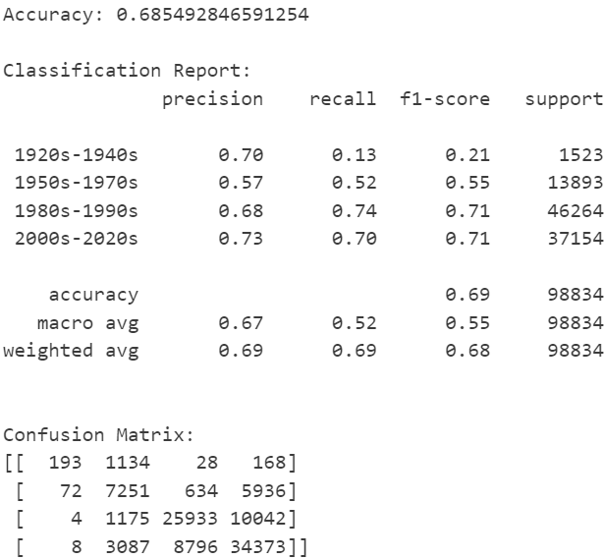
Model comparison
Multi-class Logistic Regression Model
RandomForest Classifier

Slide 10
Results

Slide 11
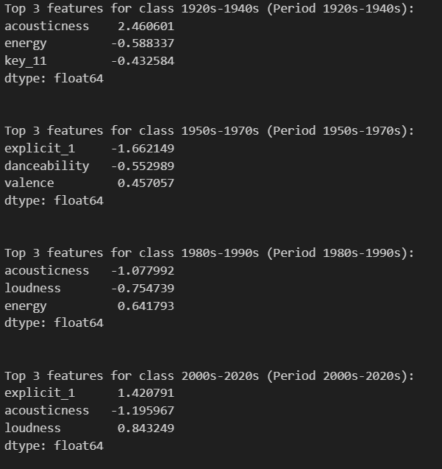
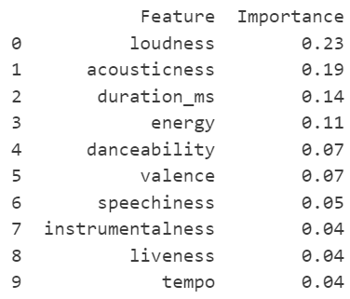
Feature Importances
RandomForest: Top 10 features to predict period
Logistic regression: Top 3 features for each predicted
period of music

Slide 12
Pros and Cons of Each Model
Multi-class Logistic Regression Model
Allows for period-specific feature interpretation
High rates of misclassification between adjacent classes.
Quite restrictive in terms of the parameters that could be tuned.
RandomForestClassifier
Performance slightly better than logistic regression model → Non-linear
More parameters to tune; gives more agency to user → Though also takes longer and difficulty to predict interaction
Longer computing time means it is more bothersome to tune
Account of changing features, rather than period-specific feature comparison

Slide 13
Potential Improvements
Increasing the sample size of tracks for older periods, particularly 1920s-1940s and 1950s-1970s.
Using class weights to address the problem of class imbalance.
Improve period identification by … … generating additional features that might help differentiate between adjacent periods … choose a different approach to period definition

Slide 14
LAB FEEDBACK
Generally, the other grouped seemed positive
Given that L2 normalization can have a large impact on the magnitude of feature importance, they noted that the result of this method would be interesting to see.
They noted that an unsupervised model may work better for our RQ to identify what combination of features would best predict year/period → This feedback could not be acted upon given the content taught in the course so far and the assignment guidelines.

